Slide 1
Git out of my dreams and git into my workflow
With your friendly guide Laurel

Slide 2
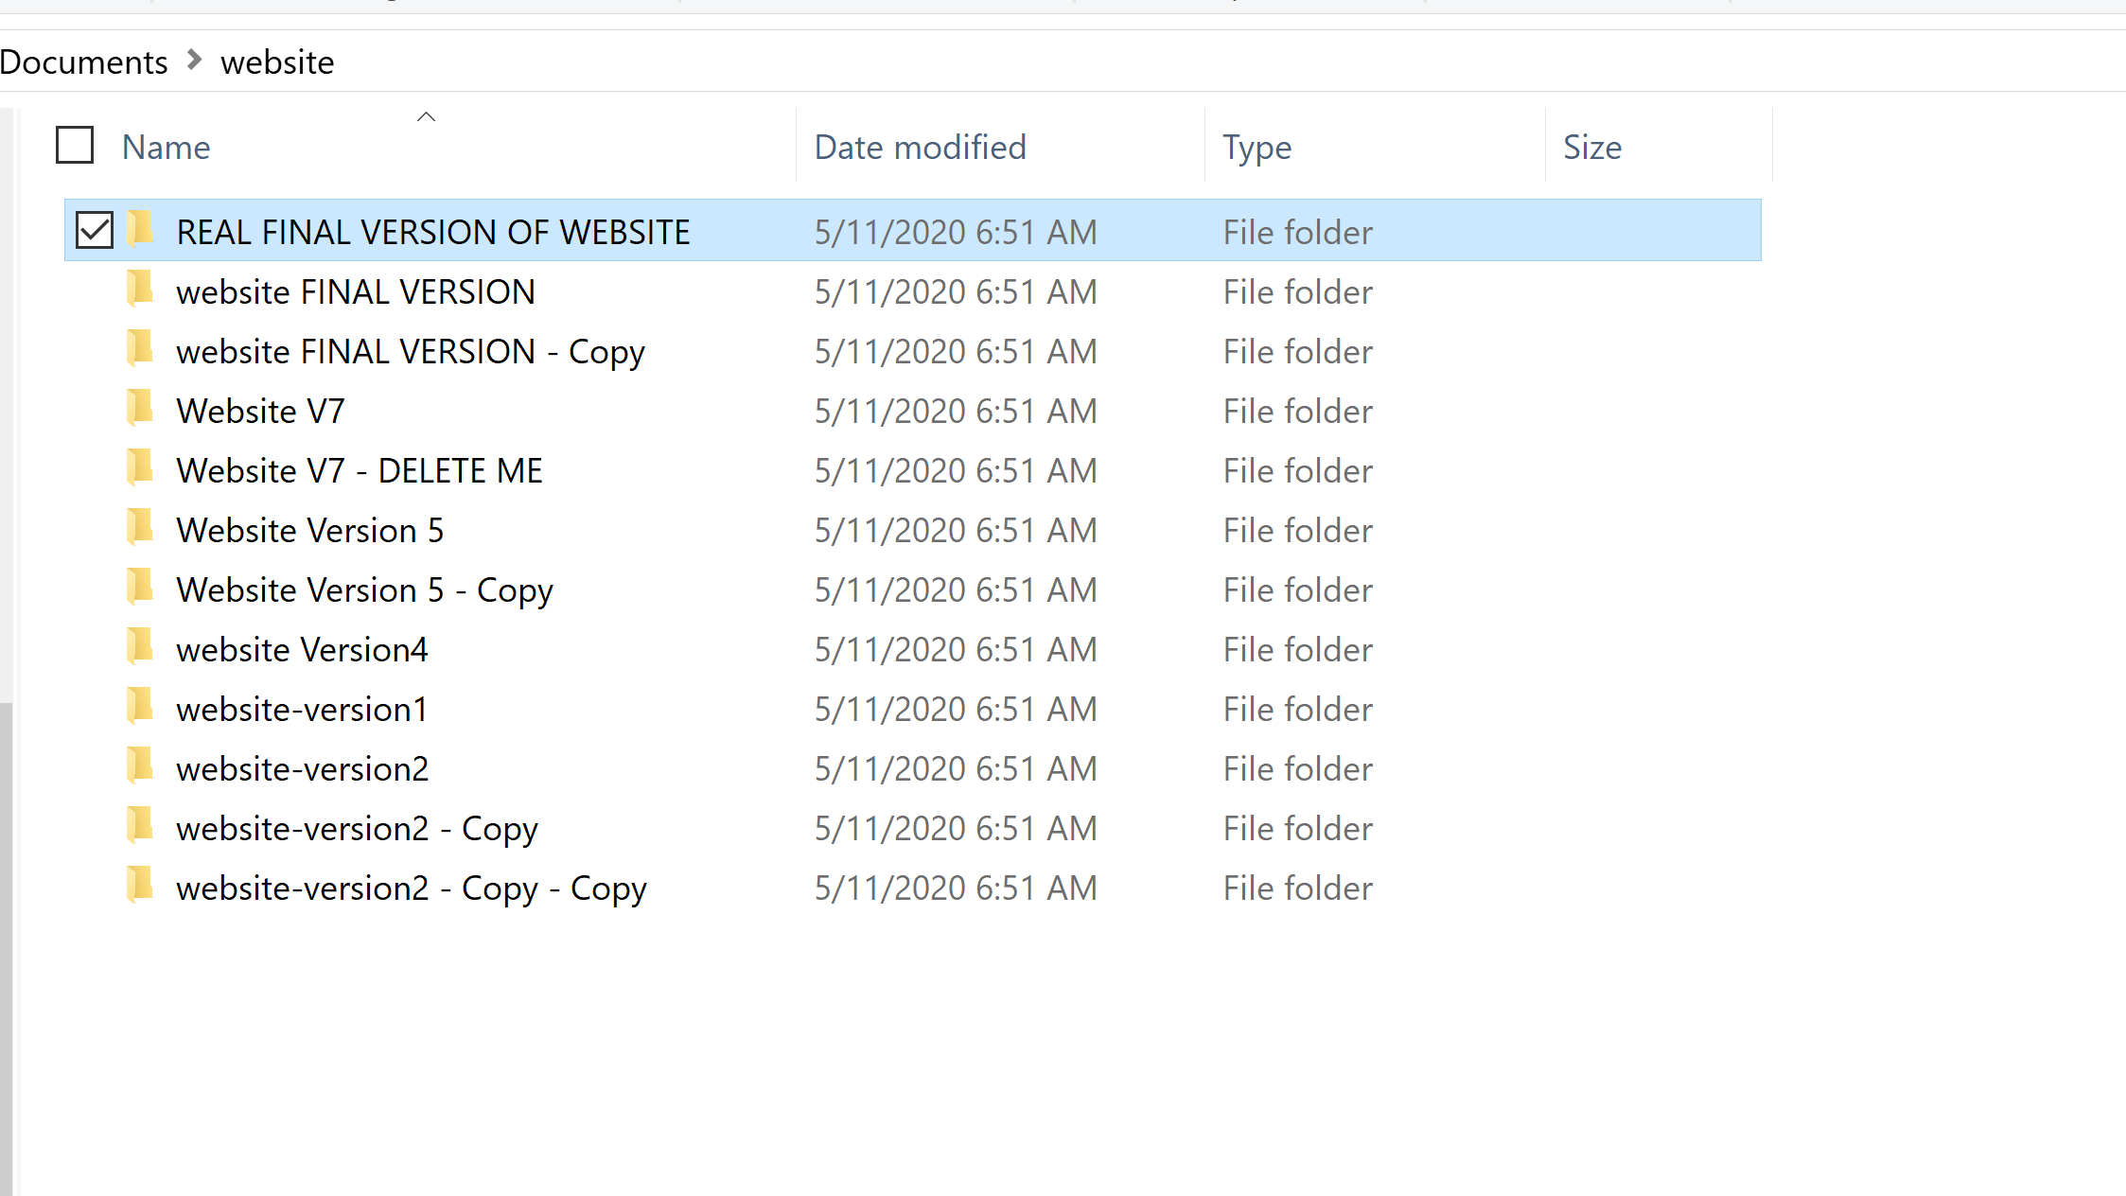
Why do we need version control?

Slide 3
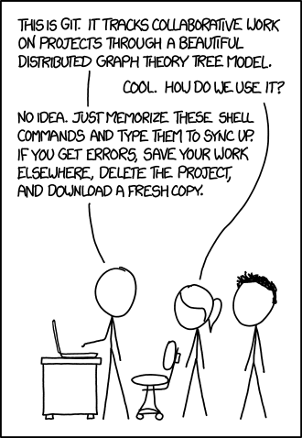
What is Git?
(why is everything so hard?)

Slide 4


Git
The software that does all the actual tracking and merging.
GitHub
An online hosting platform for git repositories

Slide 5

Initializing a git repo:

Slide 6
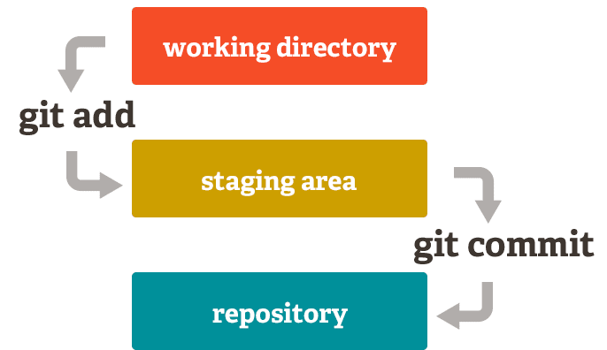
Source: https://dev.to/sublimegeek/git-staging-area-explained-like-im-five-1anh

Slide 7
My Repo
commit A
commit B

Slide 8


Adding files to staging:
Making a commit:
See the log of commits:

Slide 9
My Repo
commit A
MASTER branch
commit B
MASTER branch

Slide 10
My Repo
commit A
MASTER branch
commit B
FEATURE branch
commit C
FEATURE branch

Slide 11



Making a branch
Shortcut:

Slide 12
Pokemon Go Repo
commit A
MASTER branch
HEAD
commit B
HEAD
commit C
FEATURE branch

Slide 13

Checking out the master branch

Slide 14
My Repo
commit A
MASTER branch
commit B
FEATURE
branch
commit C
commit D
MASTER branch

Slide 15
Adding another commit to master

Slide 16
Fancy Branch Logging
Remember...A DOG
Notes:
Make sure master is checked out

Slide 17
Combining branches
Merge
or
Rebase

Slide 18
My Repo
commit A
MASTER branch
MASTER branch *
FEATURE branch *
MASTER branch *
MERGED feature branch into master branch
commit C
commit B
FEATURE branch *
FEATURE branch
MASTER branch *
Merge commit CB
* Checked out branch

Slide 19
Pokemon Go Repo
commit A
REBASED master branch onto feature branch
MASTER branch *
MASTER branch *
commit C
commit B
FEATURE branch
commit B
commit B
FEATURE branch
FEATURE branch
MASTER branch *
commit C
commit C
* Checked out branch

Slide 20

Merging
Notes:
Make sure master is checked out

Slide 21
Undoing a Merge
Notes:
Make sure master is checked out

Slide 22

Rebase
Notes:
Make sure master is checked out

Slide 23
Fancy Branch Logging
Remember...A DOG
Notes:
Make sure master is checked out

Slide 24
Putting your repo on Github
Creating a new repo on Github
Adding repo as a remote
Pushing to remote

Slide 25
There are now two repos, one locally and one on GitHub
Repo on GitHub
GitHub
Pushing content from local repo to Github repo
Adding the GitHub repo as a remote
Local
Local Repo

Slide 26
Adding GitHub repo as a remote
Notes:
Make sure master is checked out

Slide 27

Pushing local content to Github
Notes:
Make sure master is checked out

Slide 28
Using Git to collaborate

Slide 29

Cloning a repo

Slide 30
Cloning creates a copy of a repo on your local machine
Repo on GitHub
GitHub
clone
Local
Local Repo

Slide 31
Multiple people can have clones of the same repo
Repo on GitHub
GitHub
Local
Local Repo
Local Repo

Slide 32
A common workflow when collaborating with other developers is to:
Create a new branch for the specific feature you are working on
Open a pull request - or a request for the owner of the repo to ‘pull’ in the code from your branch into the master branch

Slide 33
A branch on a local repo can be pushed to a remote repo
branch:
origin/
feature
Repo on GitHub
GitHub
Local
Branch:
feature
Local Repo

Slide 34

Pushing to remote branch
(first time)
(all subsequent times)

Slide 35
We can open a request to PULL the feature branch in
branch:
origin/
feature
Repo on GitHub
GitHub
Local
Branch:
feature
Local Repo

Slide 36
PRACTICE
Have one person create a repo on GitHub and give all other group members write access
All other group members will clone the repo (use https protocol)
Everyone will create a new branch on their local repos
Everyone: make a commit on your local repo
Everyone: push your branch to the GitHub repo
Everyone: make a pull request
Owner of the repo: merge in the pull requests on GitHub (you might run into merge conflicts - follow the prompts on GitHub to resolve)

Slide 37
How do I combine changes from a REMOTE branch??
GitHub Repo
GitHub
A FETCH downloads remote commits to your repo -- but doesn’t merge anything
You can then MERGE or REBASE the new changes
Local
Local Repo
Local Repo

Slide 38
Steps to combine changes from REMOTE repo
Fetch
Bring in changes from remote repo to local repo
2) Merge OR Rebase
Combine remote commits with your commits
**PULL is shorthand for Fetch & Merge (2 commands in 1)

Slide 39
PRACTICE
Now that some of the pull requests has been merged in, everyone else’s repos will be behind origin/master, so let’s practice getting your local repo updated
Let’s update the master branch of your local repo:
Checkout the master branch
Pull the changes from the remote repo
Show the branch log to see all the commits from other group members in your repo:

Slide 40
Using Git to collaborate
Forking a repo - if you don’t have write access to a repo

Slide 41
Forking creates a copy of a repo on GitHub’s servers
Laurel’s Repo
fork
My Fork
GitHub

Slide 42
Cloning creates a copy of a repo on your local machine
Laurel’s
Repo
fork
My Fork
GitHub
clone
Local
Local Repo

Slide 43
We can add more remotes and give them aliases
Laurel’s
Repo
My Fork
GitHub
(fork)
(upstream)
Local
Local Repo

Slide 44
A branch on a local repo can be pushed to a remote repo
branch:
fork/feature
Laurel’s
Repo
My Fork
GitHub
(fork)
(upstream)
Local
Branch:
feature
Local Repo

Slide 45
Now a pull request can be created
Request for upstream/master to pull from fork/feature
branch:
fork/feature
Laurel’s
Repo
My Fork
GitHub
(fork)
(upstream)
Local
Branch:
feature
Local Repo

Slide 46
If the upstream repo accepts, the branch is merged in
branch:
fork/feature
branch:
fork/feature
branch:
fork/feature
Laurel’s
Repo
My Fork
GitHub
(fork)
(upstream)
Local
Branch:
feature
Local Repo

Slide 47
Thanks for listening!

